Slide 1


Green Pace
Security Policy Presentation
Developer: Dylan Jeffery
12/11/2021

Slide 2

OVERVIEW: DEFENSE IN DEPTH
For all software development at Green Pace, we require consistent implementation of secure principles to ensure effective defense in depth to manage.
SQL Injection
Memory Issues
Input Validation
String Values
Data Values
Assertions
&
Exceptions

Slide 3
THREATS MATRIX
Memory, String Correctness, and preventing SQL Injection are our highest priority as these are the most exploitable aspects of our system.
String references, valid iterators, data types, data values, assertions and exceptions must all be handled as these are other points of vulnerability for us.
Likely MEM50-CPP MEM52-CPP STR31-C IDS00-J | Priority P18 P18 P18 P12
Lower priority STR52-CPP(P6) INT31-C(P6) CTR53-CPP(P6) DCL30-C(P6) | Low Severity ERR50-CPP(P4) ERR51-CPP(P4)

Slide 4
10 PRINCIPLES
1. Validate Input Data [INT31-C, STR31-C, IDS00-J, STR52-CPP]
2. Heed Compiler Warnings [ERR51-CPP, CTR53-CPP]
3. Architect and Design for Security Policies [DCL30-C, STR31-C, IDS00-J, MEM50-CPP,]
4. Keep It Simple [MEM50-CPP, CTR53-CPP]
5. Default Deny
6. Adhere to the Principle of Least Privilege
7. Sanitize Data Sent to Other Systems [INT31-C, IDS00-J]
8. Practice Defense in Depth [DCL30-C, STR31-C, IDS00-J, MEM50-CPP, MEM52-CPP]
9. Use Effective Quality Assurance Techniques [ERR50-CPP]
10. Adopt a Secure Coding Standard
Notes:
INT31-C : Data Type |
Validate Input Data (While this deals with integers, we must validate input data especially if our system converts to strings)
Sanitize Data Sent to Other Systems (I considered this sanitizing and chances are that this data may be sent somewhere)
DCL30-C: Data Value |
Architect and Design for Security Policies (This is arguably a rule concerning design. It is important to understand object lifetimes are exploitable)
Practice Defense in Depth(This crosses over with the previous explanation)
STR31-C: String correctness |
Validate Input Data (All strings must be validated)
Architect and Design for Security Policies (Understand that string use is exploitable)
Practice Defense in Depth (Address buffer overflows)
IDS00-J: SQL Injection |
Validate Input Data (String use is how people utilize SQL Injection)
Architect and Design for Security Policies (SQL Injection is a common exploitable vulnerability that should be designed for)
Sanitize Data Sent to Other Systems (Sending string data can be problematic regarding SQL Injection)
Practice Defense in Depth (This provides an extra layer of defense)
MEM50-CPP: Memory Protection |
Architect and Design for Security Policies (This is protection for data in use)
Keep It Simple (Compliance with this rule is a matter of paying attention to your variables/pointers)
Practice Defense in Depth (Memory must be protected)
ERR50-CPP: Assertions |
Use Effective Quality Assurance Techniques (All efforts should be made to avoid a programs unintended termination)
ERR51-CPP: Exceptions |
Heed Compiler Warnings(Exceptions will throw warnings! Exceptions that aren’t caught can do terrible things to external resources if each is not caught.)
CTR53-CPP: Use valid iterator ranges |
Heed Compiler Warnings(The compiler or testing tools will warn about this, this must be handled or risk unintended behavior with a high remediation cost.)
Keep It Simple(Pass iterators in the proper order)
STR52-CPP: Use valid references, pointers, and iterators to reference elements of a basic_string |
Validate Input Data (Do not use an invalidated reference, pointer, or iterator because doing so results in undefined behavior)
MEM52-CPP: Detect and handle memory allocation errors |
Practice Defense in Depth (Abnormal termination must be avoided at all cost and all exceptions must be caught. Referencing a null pointer by accident can have disastrous results.)
Just because a principle is not tied to a standard does not make it less important. Default deny and Least Privilege should be evaluated on a case-by-case basis.

Slide 5
CODING STANDARDS
MEM50-CPP: Memory Protection. Do not access freed memory. This is closely tied to our encryption policies regarding data in use and memory protection is fundamental to security. Pay attention to your variables/pointers
MEM52-CPP:: Detect and handle memory allocation errors. Abnormal termination must be avoided at all cost and all exceptions must be caught. Referencing a null pointer by accident can have disastrous results.
STR31-C: String correctness. Guarantee that storage for strings has sufficient space for character data and the null terminator. Copying data to a buffer that is not large enough to hold that data results in a buffer overflow.
IDS00-J: SQL Injection. Prevent SQL injection. SQL Injection is a common exploitable vulnerability that should be designed for in which people exploit unvalidated string use. Sending string data to other systems can be problematic regarding SQL Injection
STR52-CPP: Use valid references, pointers, and iterators to reference elements of a basic_string. Since std::basic_string is a container of characters, this rule is a specific instance of CTR51-CPP. Use valid references, pointers, and iterators to reference elements of a container.
INT31-C : Data Type Ensure that integer conversions do not result in lost or misinterpreted data.
DCL30-C: Data Value. Declare objects with appropriate storage durations, object lifetimes are exploitable.
CTR53-CPP: Use valid iterator ranges. When iterating over elements of a container, the iterators used must iterate over a valid range.
ERR50-CPP: Assertions. Do not abruptly terminate the program
ERR51-CPP: Exceptions. Handle all exceptions. This ties into the idea that we must avoid abnormal termination.
Notes:
MEM50-CPP: Memory Protection |
Architect and Design for Security Policies (This is protection for data in use)
Keep It Simple (Compliance with this rule is a matter of paying attention to your variables/pointers)
Practice Defense in Depth (Memory must be protected)
MEM52-CPP: Detect and handle memory allocation errors |
Practice Defense in Depth (Abnormal termination must be avoided at all cost and all exceptions must be caught. Referencing a null pointer by accident can have disastrous results.)
STR31-C: String correctness |
Guarantee that storage for strings has sufficient space for character data and the null terminator. Copying data to a buffer that is not large enough to hold that data results in a buffer overflow.
Validate Input Data (All strings must be validated)
Architect and Design for Security Policies (Understand that string use is exploitable)
Practice Defense in Depth (Address buffer overflows)
IDS00-J: SQL Injection |
Prevent SQL injection
Validate Input Data (String use is how people utilize SQL Injection)
Architect and Design for Security Policies (SQL Injection is a common exploitable vulnerability that should be designed for)
Sanitize Data Sent to Other Systems (Sending string data can be problematic regarding SQL Injection)
Practice Defense in Depth (This provides an extra layer of defense)
STR52-CPP: Use valid references, pointers, and iterators to reference elements of a basic_string |
Validate Input Data (Do not use an invalidated reference, pointer, or iterator because doing so results in undefined behavior)
INT31-C : Data Type |
Integer conversions, both implicit and explicit (using a cast), must be guaranteed not to result in lost or misinterpreted data. This rule is particularly true for integer values that originate from untrusted sources
Validate Input Data (While this deals with integers, we must validate input data especially if our system converts to strings)
Sanitize Data Sent to Other Systems (I considered this sanitizing and chances are that this data may be sent somewhere)
DCL30-C: Data Value |
Declare objects with appropriate storage durations
Architect and Design for Security Policies (This is arguably a rule concerning design. It is important to understand object lifetimes are exploitable)
Practice Defense in Depth(This crosses over with the previous explanation)
CTR53-CPP: Use valid iterator ranges |
When iterating over elements of a container, the iterators used must iterate over a valid range.
An iterator range is a pair of iterators that refer to the first and past-the-end elements of the range, respectively.
Heed Compiler Warnings(The compiler or testing tools will warn about this, this must be handled or risk unintended behavior with a high remediation cost.)
Keep It Simple(Pass iterators in the proper order)
ERR50-CPP: Assertions |
Do not abruptly terminate the program
The std::abort(), std::quick_exit(), and std::_Exit() functions are used to terminate the program in an immediate fashion.
They do so without calling exit handlers registered with std::atexit() and without executing destructors for objects with automatic, thread, or static storage duration.
How a system manages open streams when a program ends is implementation-defined [ISO/IEC 9899:1999].
Open streams with unwritten buffered data may or may not be flushed, open streams may or may not be closed, and temporary files may or may not be removed.
Because these functions can leave external resources, such as files and network communications, in an indeterminate state, they should be called explicitly only in direct response to a critical error in the application.
Do not explicitly or implicitly call std::quick_exit(), std::abort(), or std::_Exit(). When the default terminate_handler is installed or the current terminate_handler responds by calling std::abort() or std::_Exit(), do not explicitly or implicitly call std::terminate(). Abnormal process termination is the typical vector for denial-of-service attacks.
The std::exit() function is more complex. The C++ Standard, [basic.start.main], paragraph 4, states:
Terminating the program without leaving the current block does not destroy any objects with automatic storage duration.
If std::exit is called to end a program during the destruction of an object with static or thread storage duration, the program has undefined behavior.
You may call std::exit() only in a program that has not yet initialized any objects with automatic storage duration.
Use Effective Quality Assurance Techniques (All efforts should be made to avoid a programs unintended termination)
ERR51-CPP: Exceptions |
Handle all exceptions
When an exception is thrown, control is transferred to the nearest handler with a type that matches the type of the exception thrown. If no matching handler is directly found within the handlers for a try block in which the exception is thrown, the search for a matching handler continues to dynamically search for handlers in the surrounding try blocks of the same thread.
A program that encounters an unrecoverable exception may explicitly catch the exception and terminate, but it may not allow the exception to remain uncaught. One possible solution to comply with this rule, as well as with ERR50-CPP, is for the main() function to catch all exceptions. While this does not generally allow the application to recover from the exception gracefully, it does allow the application to terminate in a controlled fashion.
Heed Compiler Warnings(Exceptions will throw warnings! Exceptions that aren’t caught can do terrible things to external resources if each is not caught.)

Slide 6
ENCRYPTION POLICIES
Encryption in rest - Protecting data that is stored on devices. This is an important aspect of any defense as all stored data must be protected.
Encryption at flight - Protecting data that is being sent. Encrypting in-flight data to secure communications across fiber-optic cables can help eliminate gaps within your data security strategy.
Encryption in use - Like encryption in rest, however the data is in memory instead of on disk.

Slide 7
TRIPLE-A POLICIES
Authentication - Authentication provides a method of identifying a user, typically by having the user enter a valid username and password before access to the network is granted. Authentication is based on each user having a unique set of login credentials for gaining network access.
Authorization - Following authentication, a user must gain authorization for doing certain tasks. After logging in to a system, for instance, the user may try to issue commands. The authorization process determines whether the user has the authority to issue such commands.
Accounting - The final piece in the AAA framework is accounting, which monitors the resources a user consumes during network access. This can include the amount of system time, or the amount of data sent and received during a session.
Notes:
Authentication
The AAA server compares a user's authentication credentials with other user credentials stored in a database; in this case, that database is Active Directory. If the user's login credentials match, the user is granted access to the network. If the credentials don't match, authentication fails, and network access is denied.
Authorization
Simply put, authorization is the process of enforcing policies—determining what types or qualities of activities, resources, or services a user is permitted. Usually, authorization occurs within the context of authentication. After you have authenticated a user, they may be authorized for different types of access or activity.
As it relates to network authentication via RADIUS and 802.1x, authorization can be used to determine what VLAN, Access Control List (ACL), or user role that the user belongs to.
Accounting
Accounting is carried out by logging session statistics and usage information.
It is used for authorization control, billing, trend analysis, resource utilization, and planning for the data capacity required for business operations.
ClearPass Policy Manager functions as the accounting server and receives accounting information about the user from the Network Access Server (NAS). The NAS must be configured to use ClearPass Policy Manager as an accounting server, and it is up to the NAS to provide accurate accounting information to ClearPass Policy Manager.

Slide 8
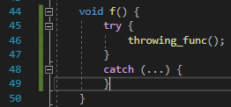
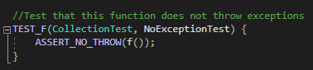
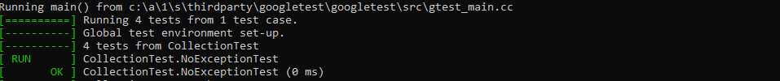
Will exceptions being thrown terminate the program?
Handle All Exceptions.

Slide 9
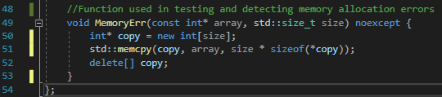
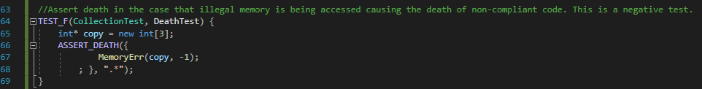
Detecting and handling memory allocation errors.
This Death Test combines us testing
Memory allocation errors
ASSERT_DEATH tests for abnormal program termination in our memory allocation function.
Negative Test
Notes:
Abnormal process termination is the typical vector for denial-of-service attacks.

Slide 10
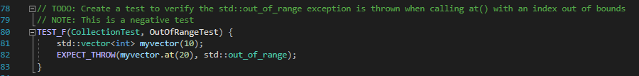
Are out of range errors being handled?
Handling more exceptions
This time implementing testing for a straightforward EXPECT_THROW

Slide 11
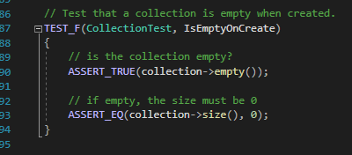
Are our collections being initialized correctly?
These mainly will aid with string correctness and using appropriate iterators.
This is a positive test.

Slide 12

AUTOMATION SUMMARY

Slide 13
TOOLS
The goal of DevSecOps is to unify software development, security, and operations. The main characteristic of this culture/practice is to automate, monitor, and apply security to every phase of the software lifecycle: Plan(Think about potential threats as much as features), Design(test driven design), Build, Verify/test(CppCheck, Static/Unit Testing), transition(Configure Security), and health check, Monitor/Detect (Firewalls), Respond, Maintain & Stabilize. DevSecOps is unique in that security and functional capabilities are tested and built simultaneously.
Parasoft C/C++test as well as Astrée are proven and well tested automated suites with many Static testing options for both C and C++.
CppCheck and LDRA also are great tools for developing secure software.

Slide 14
RISKS AND BENEFITS
Considering the security policy laid out in this presentation we can start with our benefits: Memory issues, SQL Injection, string correctness, valid iterators, data types, data values, valid references, assertions, and exceptions are all handled in this policy. This offers us a foundation to implementing an effective Defense in Depth strategy.
This security policy does have a few risks that must be considered at all stages of development. Default Deny and the Principle of Least Privilege are not explored deeply in the standards highlighted. These are fundamental principles that cannot be ignored. Each case/system should be evaluated independently in order to establish appropriate user/thread privileges.

Slide 15
RECOMMENDATIONS
As mentioned, the gaps in this security policy come from a lack of attention paid to ensuring appropriate user privileges and default deny.
It is for this reason that each use/system must be evaluated on a case-by-case basis to establish correct implementations of default deny/least necessary user privilege.
We should always be developing with tests in mind.
Constantly test through both Static and Unit testing.

Slide 16
CONCLUSIONS
In the future, standards should be integrated into this security policy to address Default Deny and Least User Privilege.
Always Be Testing (Unit and Static)
Configure and maintain network security (Firewalls, Secure Repositories, etc.)

Slide 17
REFERENCES
Confluence https://wiki.sei.cmu.edu/confluence/display/seccode/SEI+CERT+Coding+Standards

